Slide 1
Climate Review and Outlook
Ryan Boyles
State Climatologist
North Carolina State University
ryan_boyles@ncsu.edu
Mike Moneypenny
Hydrologist / Forecaster
NOAA National Weather Service - Raleigh
Michael.Moneypenny@noaa.gov

Slide 2
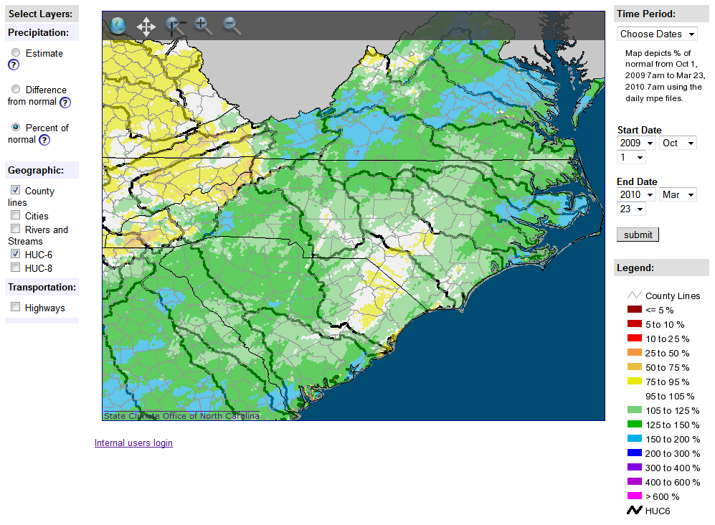
October 2009 – March 2010

Slide 3
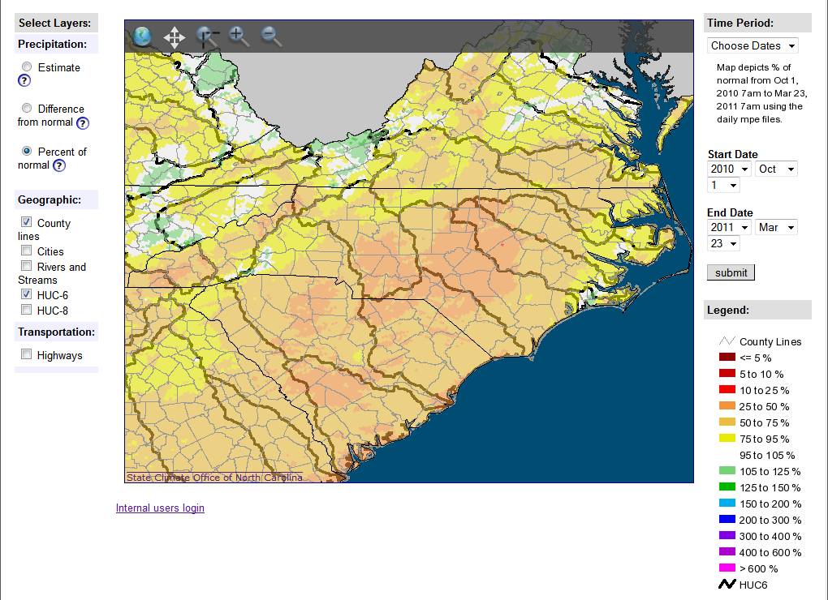
October 2010 – yesterday

Slide 4
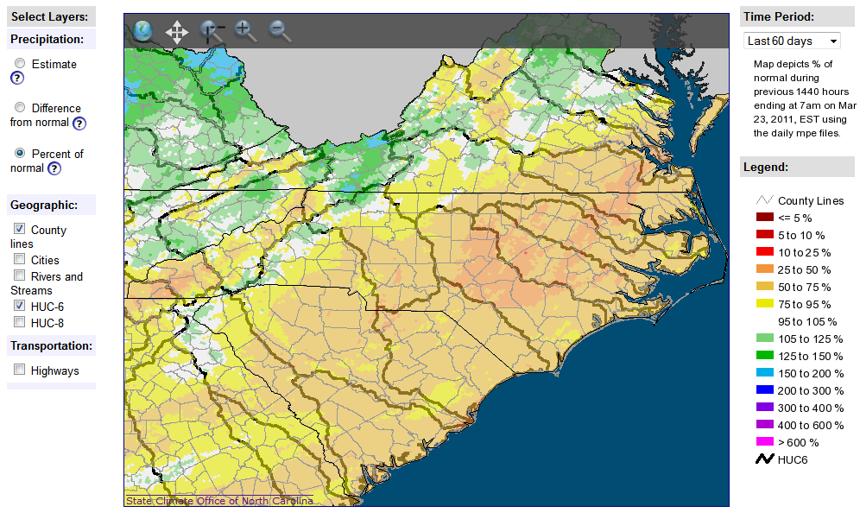
Last 60 days

Slide 5
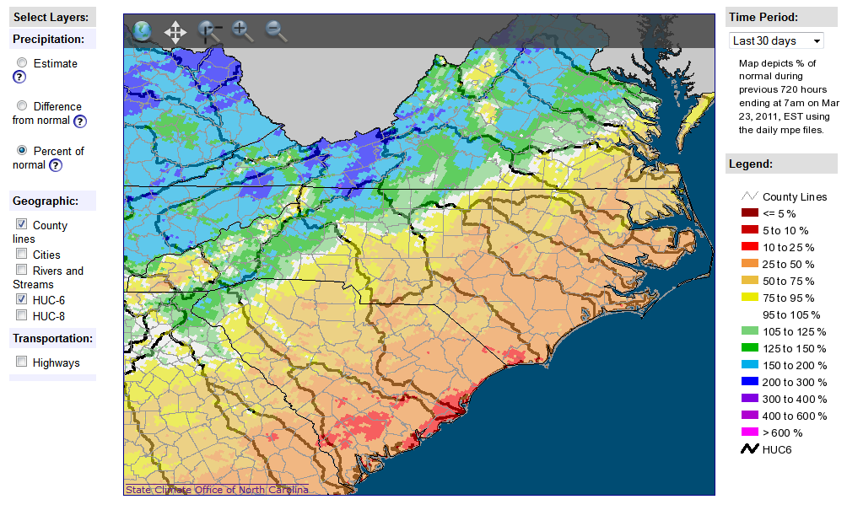
Last 30 days

Slide 6
Short-term Outlook
Last
Night’s
Rainfall

Slide 11
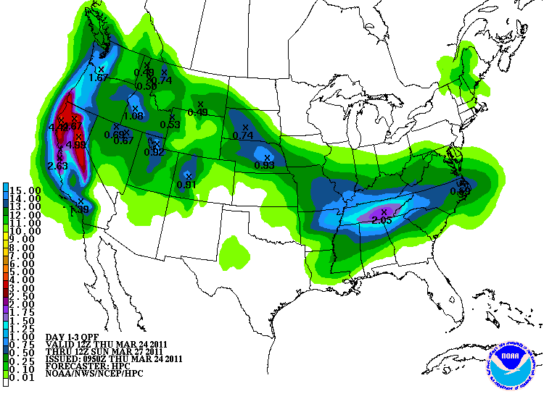

Slide 15
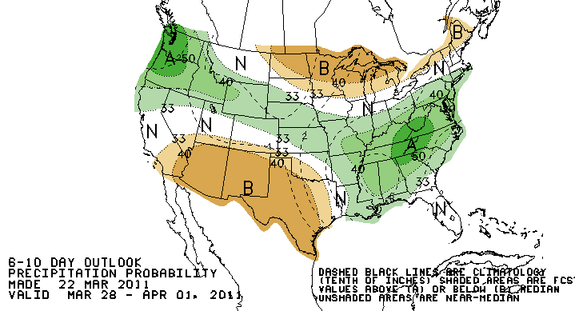
NWS 6-10 Day Outlook

Slide 16
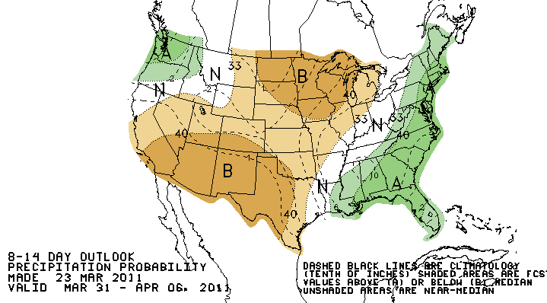
NWS 8-14 Day Outlook

Slide 17
ENSO Outlook
El Nino event in winter 2009-2010
El Nino typically associated with wetter winters in NC (esp central, eastern NC)
La Nina event in winter 2010-2011
La Nina typically associated with drier winters in NC (esp central, eastern NC)

Slide 18
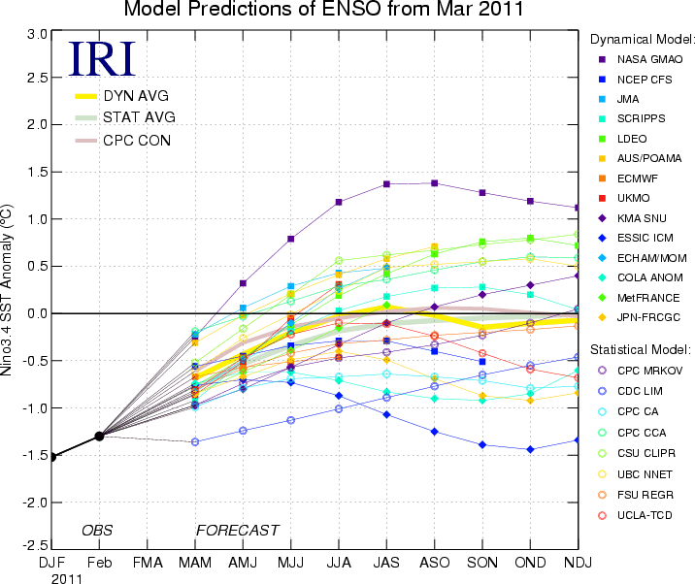

Slide 19
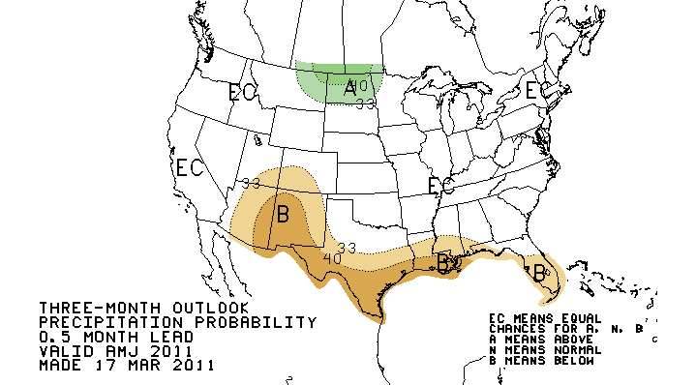
NWS Precip Outlook: AMJ

Slide 23
Summary
Its been a dry winter, especially in central and eastern NC
Wetter recently in Mountains
La Nina fading
No guidance for summer (as usual)
Still too early to predict ENSO for next winter

